Slide 1

Swagger Petstore
API Testing Project
Team Members: Youssef Yasser & Omar Abdelhakem
Supervised by: Dr. Amany Shousha

Slide 2


Project Introduction: Elevating API Quality
This project delves into comprehensive API testing, focusing on the Swagger Petstore demo API. Our goal was to ensure the reliability, functionality, and performance of critical API endpoints.
API Functionality
Robustness & Stability
Automation Foundation
Verify correct data handling and endpoint responses.
Identify vulnerabilities and ensure consistent performance.
Build a scalable and maintainable automation framework.

Slide 3
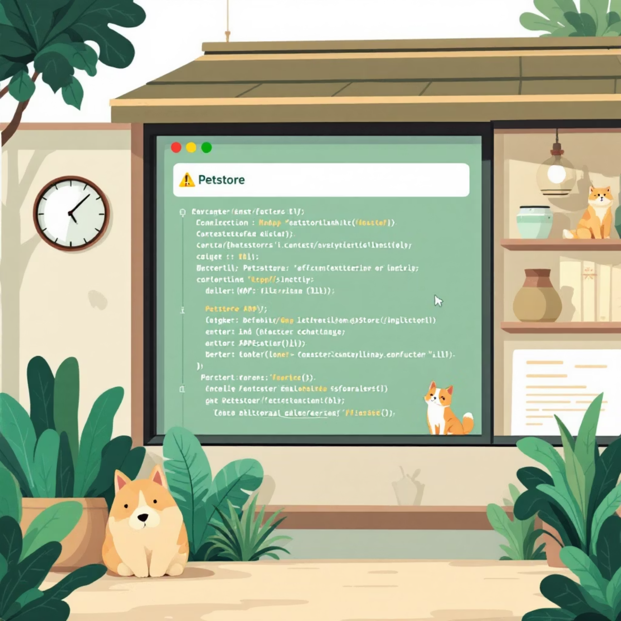
Exploring Swagger Petstore: A Testing Playground
Swagger Petstore serves as an ideal environment for learning and practicing API testing. It offers a well-documented API with various functionalities.
Key Endpoints:
/pet: Operations related to pets (add, update, find).
/store: Manages pet store orders and inventory.
/user: Handles user accounts and authentication.
These diverse endpoints provide ample scope to test different HTTP methods and data models.

Slide 4
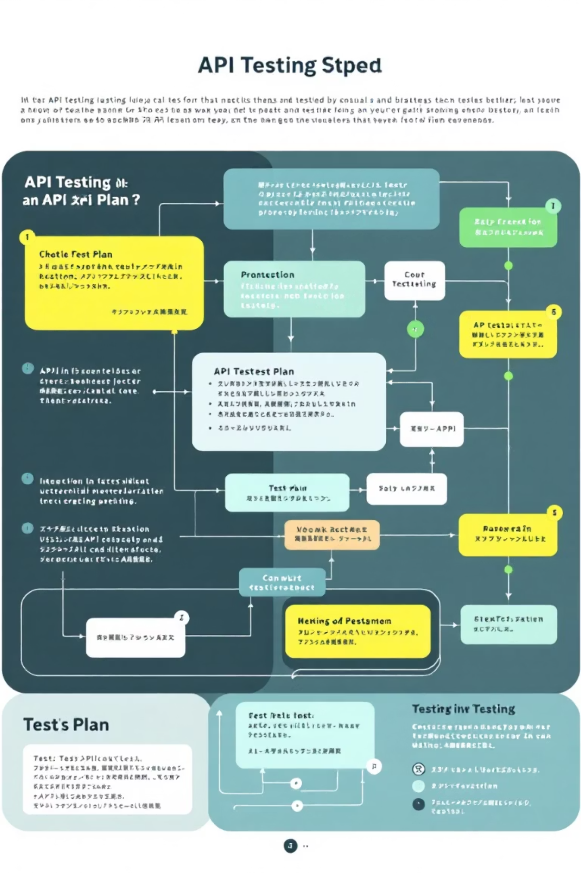
Strategic API Testing: Our Comprehensive Plan
Our testing approach was meticulously planned to ensure thorough coverage and validation of the Swagger Petstore API.
01
1. Scope Definition
Focused on critical Petstore functionalities: adding, updating, retrieving, and deleting pets, users, and orders.
02
2. Test Types
Included smoke tests for basic functionality, functional tests for detailed validation, and regression tests for stability.
03
3. API Validation
Checked HTTP status codes, response headers, JSON schema validation, and data integrity.
04
4. Request/Response
Analyzed request payloads and confirmed expected response structures.

Slide 5
Essential Tools & Techniques for API Testing
Leveraging industry-standard tools was crucial for efficient and effective API testing and automation.
Postman
REST Assured
Swagger UI
Manual and automated API testing, request chaining, environment management.
Java-based library for robust API test automation.
Interactive API documentation and basic testing interface.
JSON Validation
TestNG
Ensuring response data conforms to expected schema.
Test framework for managing and executing test cases.

Slide 6


Postman in Action: Dynamic API Exploration
Postman was instrumental in quickly prototyping requests, validating responses, and building comprehensive test collections.
Request Types: Executed GET, POST, PUT, and DELETE requests for various Petstore endpoints.
Test Scripts: Wrote JavaScript to assert response status, body content, and headers.
Chaining Requests: Demonstrated dependencies between requests, e.g., creating a pet, then fetching it.
Environment Variables: Managed different base URLs and API keys for flexible testing.

Slide 7
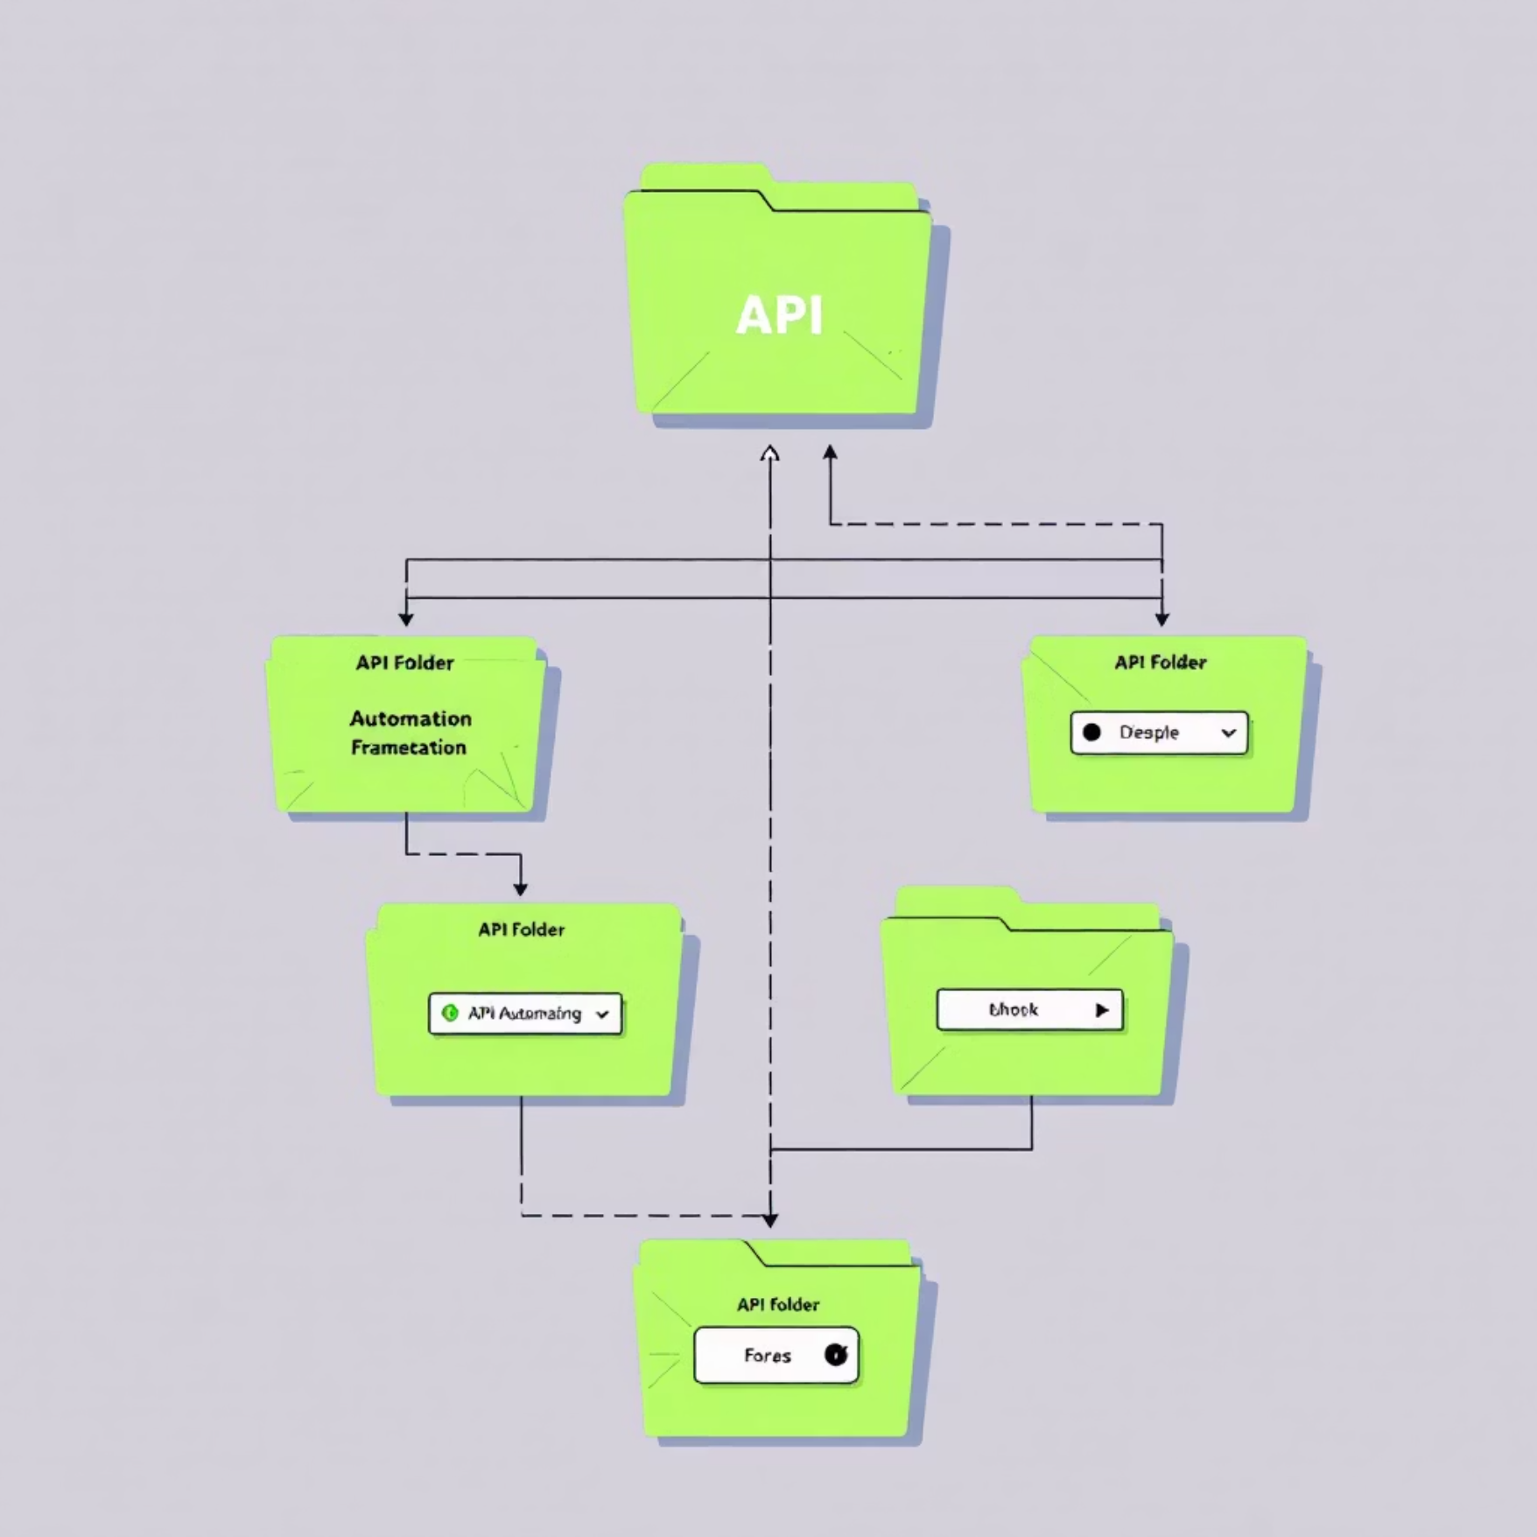
REST Assured: Powering API Automation
For robust and scalable automation, REST Assured with Java provided a powerful framework to validate complex API scenarios.
Framework Structure
Sample Test Flow
Organized tests into clear, maintainable packages for easy navigation and execution.
given()
.contentType(ContentType.JSON)
.body(petPayload)
.when()
.post("/pet")
.then()
.statusCode(200)
.body("name", equalTo("doggie"))
.body("status", equalTo("available"));
This snippet demonstrates creating a pet and validating its attributes.
We focused on validating response codes for expected outcomes and ensuring the JSON body contained accurate data, making our automation suite highly reliable.

Slide 8
Reporting & Achievements: Measuring Success
Our project yielded significant insights into API quality, highlighted by comprehensive reporting and key learnings.
95%
12
100%
Automation Coverage
Bugs Identified
API Quality Improvement
Achieved high coverage for critical Petstore API endpoints.
Uncovered minor issues related to data validation and error handling.
Ensured API reliability and robustness for future development.
Beyond the metrics, I gained invaluable experience in API testing methodologies, tool proficiency, and automation best practices.

Slide 9

Challenges & Future Enhancements
Every project presents opportunities for growth. We tackled several challenges and identified exciting future directions.
1. Data Management
1
Issue: Dynamic test data creation. Solution: Implemented data providers and utility methods.
2. Test Stability
2
Issue: Intermittent failures. Solution: Introduced explicit waits and robust assertions.
3. CI/CD Integration
3
Future: Integrate automation suite with Jenkins/GitHub Actions for continuous testing.
4. Performance Testing
4
Future: Add performance tests using JMeter to assess API responsiveness under load.

Slide 10




Conclusion & Key Takeaways
This project was a comprehensive journey into the world of API testing, reinforcing critical skills and insights.
API Mastery
Automation Prowess
Deep understanding of API architecture and testing principles.
Proficiency in building and maintaining robust automation frameworks.
Collaboration
Quality Advocate
Learned the importance of clear communication and shared goals in project success.
Commitment to delivering high-quality, reliable software through rigorous testing.
Thank you for your attention.

